Slide 1
Project Name – Insurance Analysis
Domain-Insurance

Slide 2
Summary
Objective:The primary objective is to create a dynamic and insightful dashboard that helps corporate teams and branch heads monitor and enhance branch performance, ensuring alignment with overall business goals.
Tools and technology: powerBi , Tableau,Excel,MySQL
Benefits:
Enhanced Visibility: Provides clear insights into performance metrics at both branch and individual levels.
Data-Driven Decisions: Facilitates strategic decision-making based on accurate and up-to-date data.
Targeted Strategies: Helps identify areas for improvement and develop targeted strategies to boost business performance.
Improved Accountability: Encourages accountability by tracking individual contributions and achievements.

Slide 3
KPI’s list
Number of Invoice by Account Executive.
Yearly Meeting Count.
Cross Sell -Target, Achive, New.
New - Target, Achive, New.
Renewal - Target, Achive, New.
Stage Funnel by Revenue.
Number of Meeting By Account Executive.
Top Open Opportunity.

Slide 4
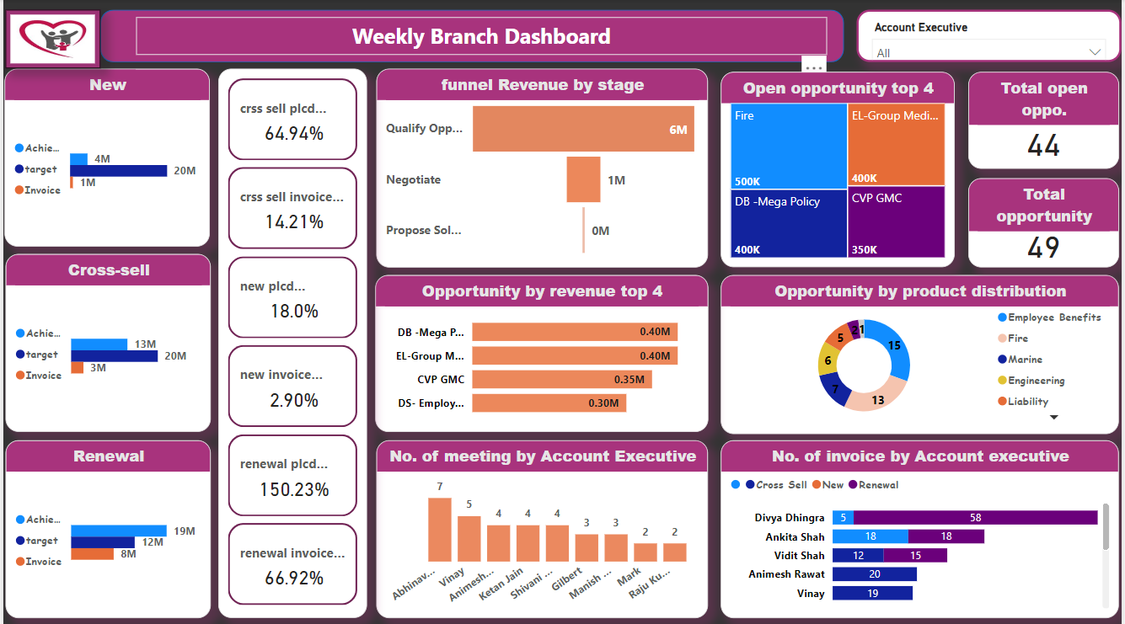
PowerBi Dashboard

Slide 5
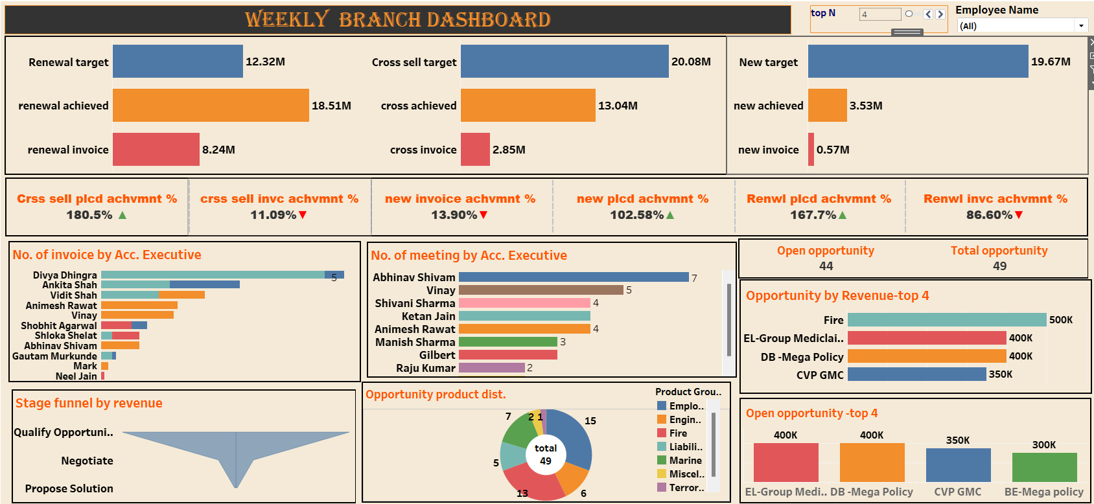
Tableau Dashboard

Slide 6
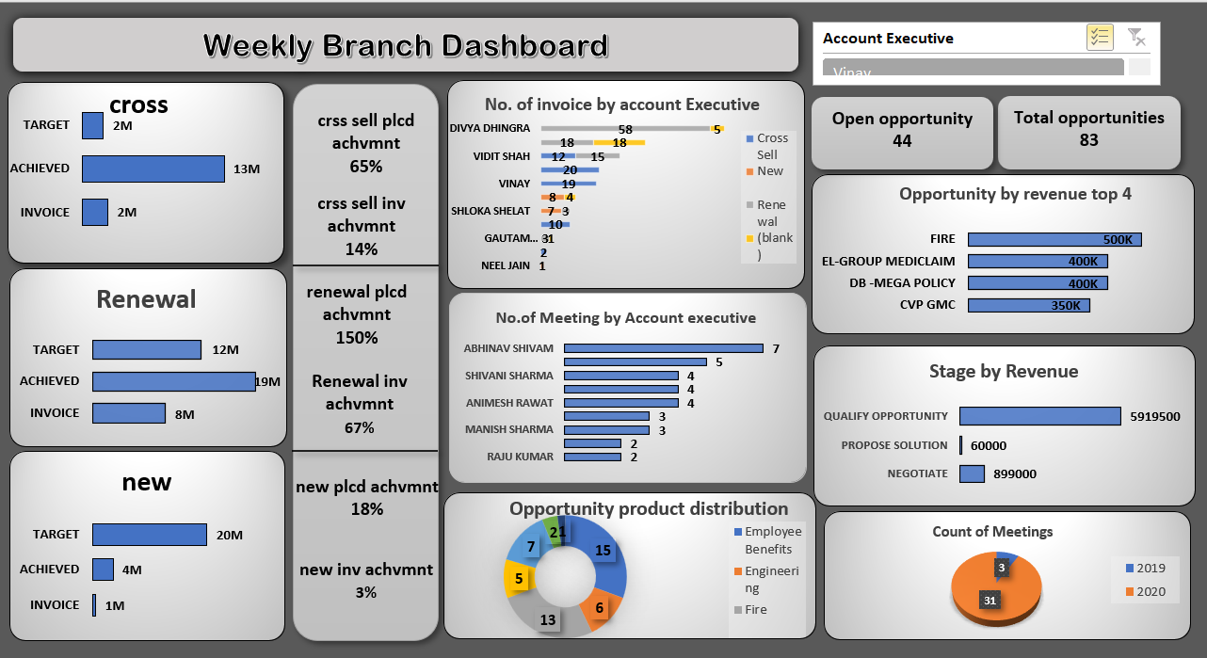
Excel Dashboard

Slide 7
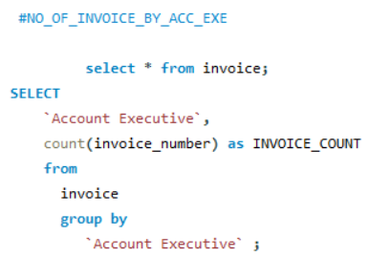
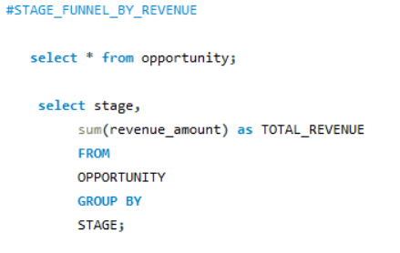
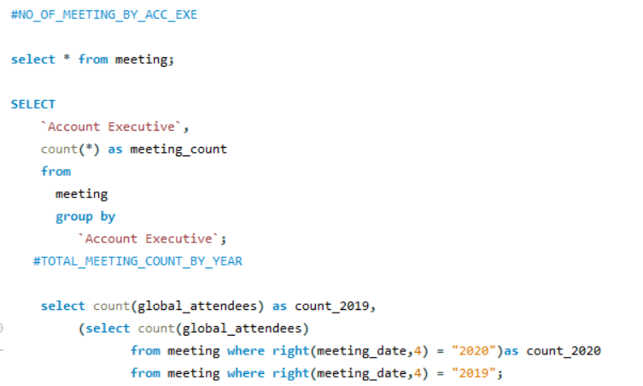
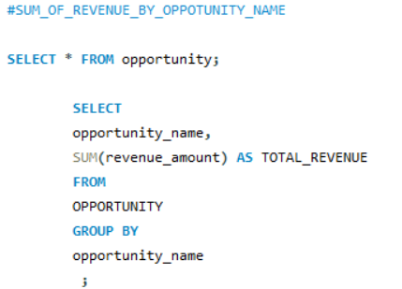
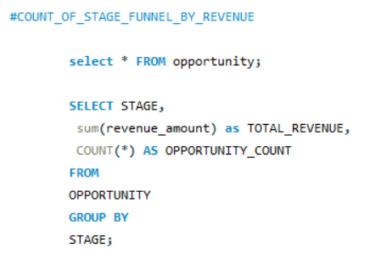
SQL queries

Slide 8
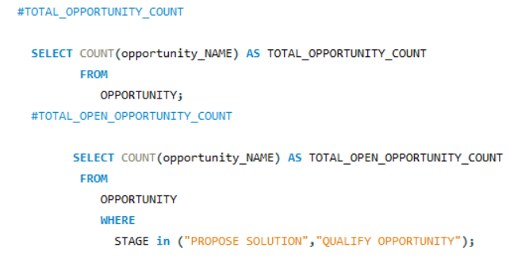
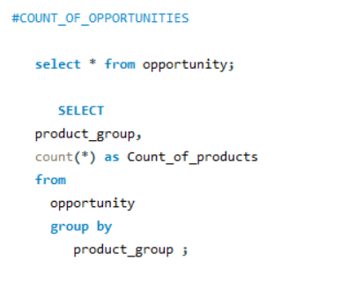
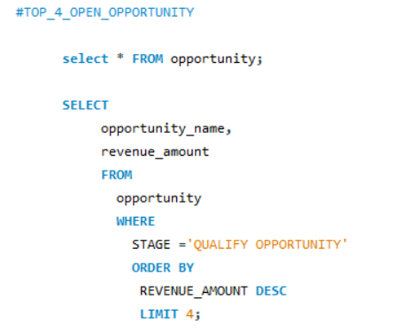
SQL queries

Slide 9
Key takeaways
Comprehensive Performance Analysis: The dashboard provides a detailed overview of new and renewal business numbers, facilitating performance discussions between the corporate team and branch heads.
Target vs. Achievement: It effectively compares target figures with actual achievements for new, cross-sell, and renewal business across multiple metrics.
Meeting Metrics: Tracks the number of meetings conducted throughout the year, offering insights into engagement levels and their impact on business outcomes.
Opportunity Management: Highlights the status of open opportunities and conversion rates, aiding in identifying potential leads and successful closures.
Individual Accountability: Enables monitoring of individual performance within branches, promoting accountability and targeted improvements.
Data-Driven Decision Making: The integration with Power BI and Tableau and Excel ensures dynamic, real-time data visualization, enhancing strategic planning and operational efficiency.

Slide 10
THANK YOU!!!!!

